Slide 1

Pictures copyright-free from pixabay
Leader: We are a creative community. As we gather together today…
ALL: May our thinking, talking and wondering help us to grow.
Notes:
Slide 1: Gathering
Use the new greeting, with BSL actions if desired.
Leader: We are a creative community. As we gather together today….
ALL: May our thinking, talking and wondering help us to grow.
Here are BSL actions for some of the words:
Leader’s words:
Creative: https://www.signdictionary.co.uk/view/creative?q=creative#title
Community: (we use the word ‘gathering’ as it’s a simpler sign!) https://www.signbsl.com/sign/gathering
Gather together: https://www.signbsl.com/sign/gather (1st video)
Pupils’ response:
Think: https://www.brightbsl.co.uk/signs/think
Talk: https://www.signbsl.com/sign/talk (1st video)
Wonder: https://www.signbsl.com/sign/wonder (1st video)
Grow: https://www.signbsl.com/sign/grow (2nd video)

Slide 2
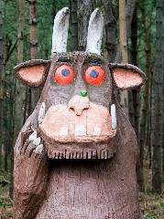
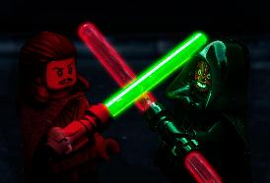
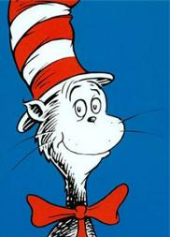
A mouse took a stroll through a deep dark wood. A fox saw the mouse and the mouse looked good…
A long time ago, in a galaxy far, far away…….
The sun did not shine, it was too wet to play. So we sat in the house all that cold, cold, wet day…
Beginnings
Notes:
Slide 2: At the beginning of our time together today, we are going to think about Beginnings! We heard the words ‘In the beginning’ at the start of our story last week, and today, we are going to use some more words of beginning to help us to think….
I wonder if you know which stories these words are the beginning of?....Talk together with a partner and then we’ll see if you’re right…
A mouse took a stroll through a deep dark wood. A fox saw the mouse and the mouse looked good… THE GRUFFALO
A long time ago, in a galaxy far, far away… STAR WARS
The sun did not shine, it was too wet to play. So we sat in the house all that cold, cold, wet day… THE CAT IN THE HAT (Dr. Seuss)
I wonder what other story beginnings you can remember? [ask for some other examples]

Slide 3

Notes:
Slide 3: Beginnings are important.
The beginnings of stories are words that we remember!
Beginnings often help us to understand a story better.
We are beginning a new term, and a new school year.
Some of you are beginning at our school.
[Most of] You are beginning in a new class with a new teacher.
We are beginning a whole new series in our times together in collective worship.
Beginnings are important.

Slide 4
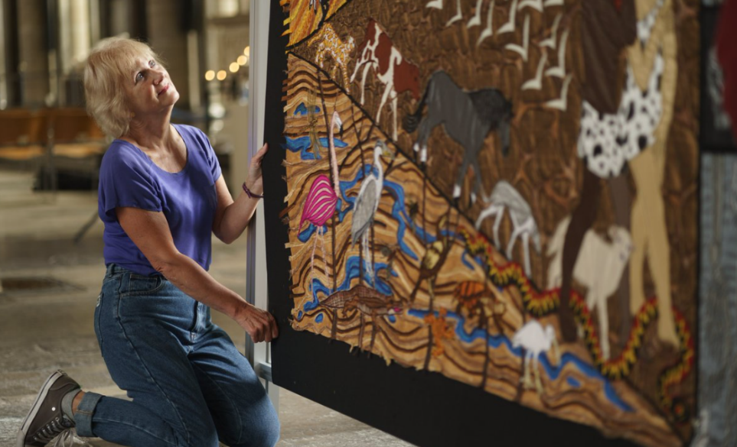
Creativity
Notes:
Slide 4: Creativity
Last week, we thought about this big word that will be a common theme for the rest of this term, as we continue to use the work of textile artist Jacqui Parkinson.
Next week we will begin looking at the work from her new exhibition, but in order for us to fully understand it, we need to return to last week’s story of beginnings, when ‘God made….’

Slide 5
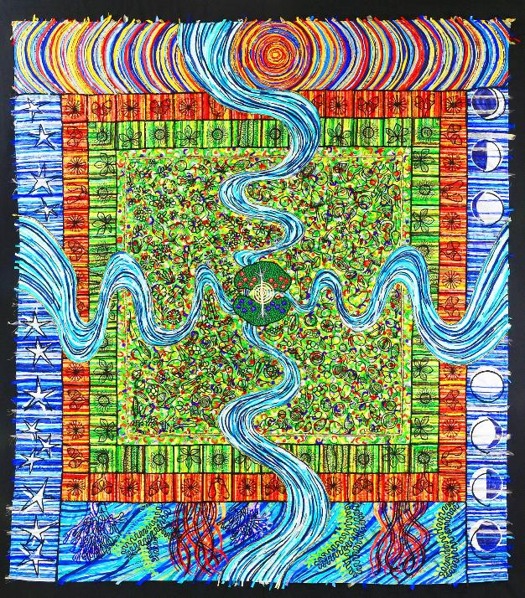
That’s good!!
Notes:
Slide 5: Do you remember the words that God spoke after he’d made?..... He said ‘That’s good!’
He looked at the world that he had created and was pleased. I’m sure that most of us can identify with how it feels to be pleased with the things we have made! God gave the world to Adam and Eve and told them that it was their job to look after it, to care for it and help it to flourish. The world he had made was perfect, and in the very middle of it, God planted the most beautiful garden. God called it Eden. It was the perfect place.

Slide 6
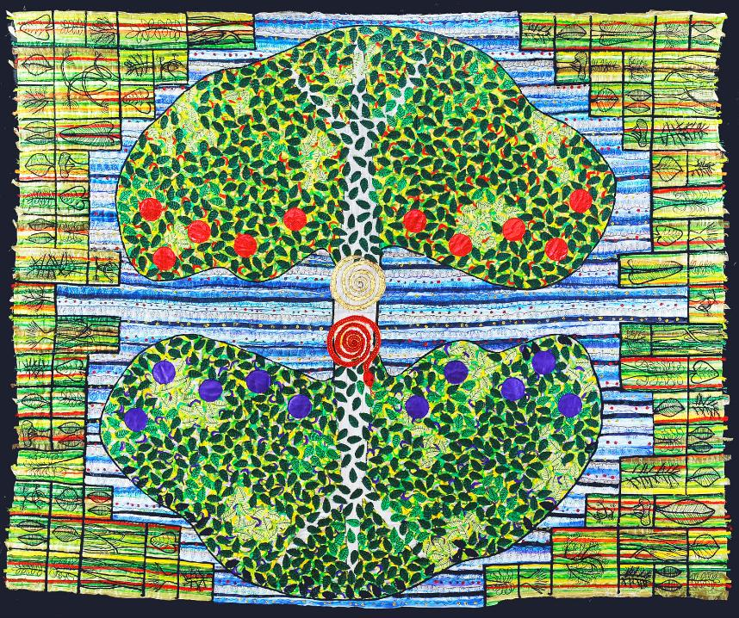
….I wonder what Adam and Eve might have thought about God’s instructions?....
Notes:
Slide 6: In the middle of the garden, God had planted two special trees.
One was the tree of life – you can see it, here, with the golden spiral, and the red fruit.
The second tree had a very big name: the Tree of the Knowledge of Good and Evil. You can see it here, with the blue fruit. Can you see what the red spiral is?.... [it’s a snake]
God shared the Garden of Eden with Adam and Eve – and he told them they could eat any seed or fruit from the garden EXCEPT for the fruit of these two special trees. It would not be good for them!
….I wonder what Adam and Eve might have thought about God’s instructions?.... [you might want to allow children some time to talk together about this]

Slide 7
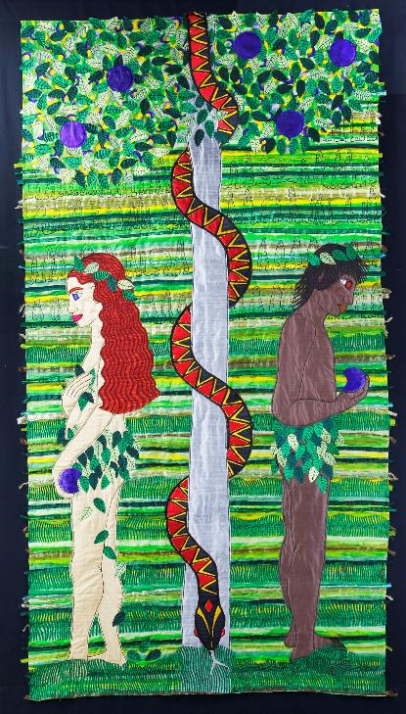
….I wonder how Adam and Eve feel now?....
….I wonder how God feels about what’s happened?....
Notes:
Slide 7: Unfortunately, God’s enemy, Satan, was in the garden in the form of a snake and he whispered to the people that it wouldn’t matter if they disobeyed God, that if they ate the fruit of the Tree of the Knowledge of Good and Evil, then they would be like God and know everything…. Well, that was too great a temptation for them, and as you can see here, they took the fruit and ate it.
….I wonder how Adam and Eve feel now?....[you might want to allow children some time to talk together about this]
Immediately they did this, they knew that they had done wrong and hid from God amongst the trees, ashamed of their actions. When God walked in the garden in the cool of the day, looking for his friends Adam and Eve, they were nowhere to be found, so he called their names until they came out from where they had been hiding. They each blamed each other and the snake…..
….I wonder how God might feel about what’s happened?....[you might want to allow children some time to talk together about this]

Slide 8
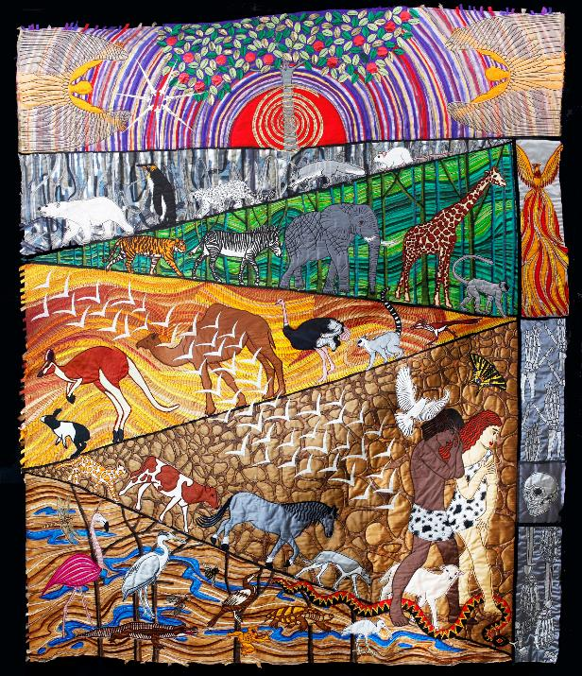
….I wonder how you feel as you look at what’s happening?....
….I wonder how Adam and Eve feel now?....
Notes:
Slide 8: The story tells us that God was very disappointed and that he sent Adam and Eve away from the perfect Garden, because things could no longer be perfect. Because Adam and Eve had listened to the snake, Sin had come into the world and spoiled it. Life in the world would be hard work now, and Adam and Eve would not be able to live with God in the perfect Garden. God closed the Garden so that no one would ever be able to eat from the special trees again. It seems that this beginning has gone all wrong….
Spend a few moments really looking at this part of Jacqui’s work now…..
….I wonder how you feel as you look at what’s happening?.... [you might want to allow children some time to talk together about this]
….I wonder how Adam and Eve feel now?....[you might want to allow children some time to talk together about this]
For Christians, this is the saddest moment in the whole story, as the whole of Creation is affected by what happened. God’s perfect world is broken….

Slide 9
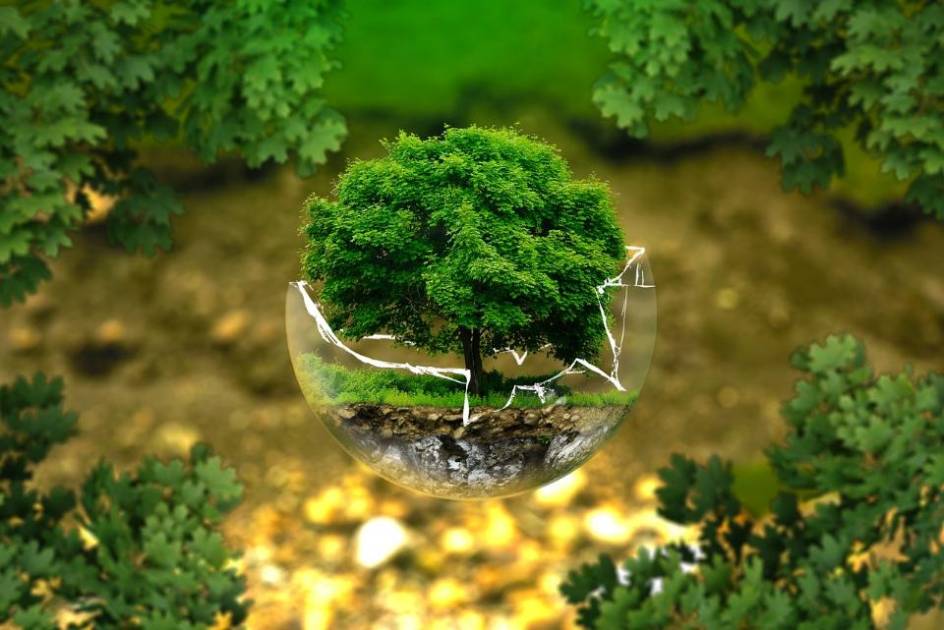
….I wonder what you think about this idea?....
….when you look at the world, I wonder if you agree that it is ‘broken’?....
....I wonder how we should act now?....
Notes:
Slide 9: Responding and words for worship
….I wonder what you think about this idea?....
….when you look at the world, I wonder if you agree that it is ‘broken’?....
....I wonder how we should act now?....
[you might want to allow some time for discussion here as well]
These are things that we will take into our classrooms this week as we continue to think about our responsibilities as human beings for the world around us….which includes the way that we treat each other. We can all make a difference in caring for a world that is still beautiful and amazing, but fragile…..and as we’ll find out next week, for Christians, the story doesn’t end with this broken beginning…..
Opportunity for reflection / prayer
I’m going to pray now. If this is something that you feel comfortable doing, then there will be some words for us to share together. If you don’t want to pray, then use the quiet to be still with your own thoughts. Here are the words….

Slide 10

We will show we care.
Notes:
Slide 10: We will show we care.

Slide 11
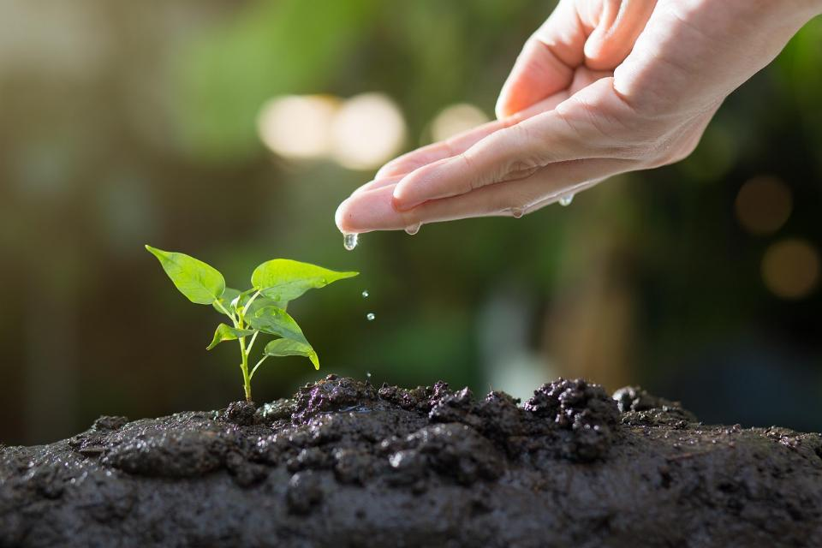
Notes:
Slide 11: In the world that is our home….

Slide 12
We will show we care.
Notes:
Slide 12: We will show we care.

Slide 13
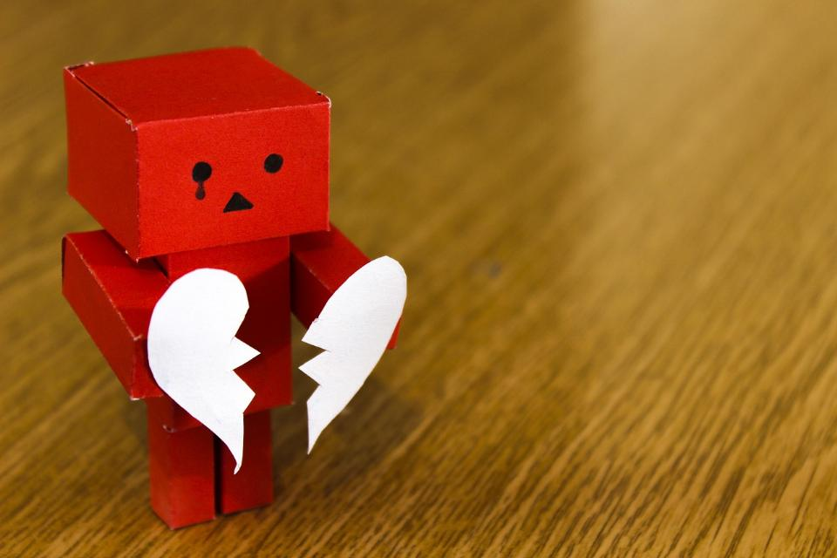
Notes:
Slide 13: For the places that feel broken….

Slide 14
We will show we care.
Notes:
Slide 14: We will show we care.

Slide 15
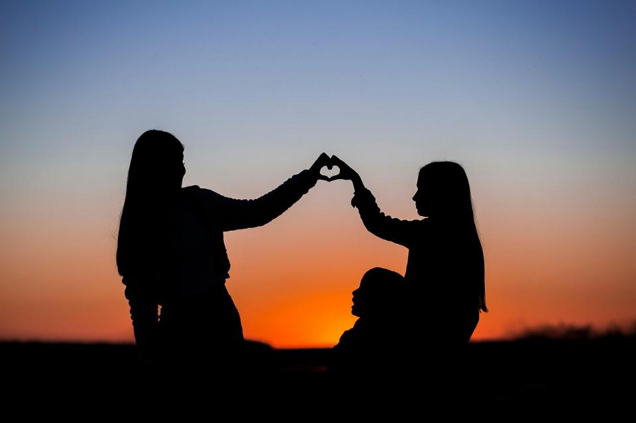
Notes:
Slide 15: In the friendships that we cherish….

Slide 16
We will show we care.
Notes:
Slide 16: We will show we care.

Slide 17
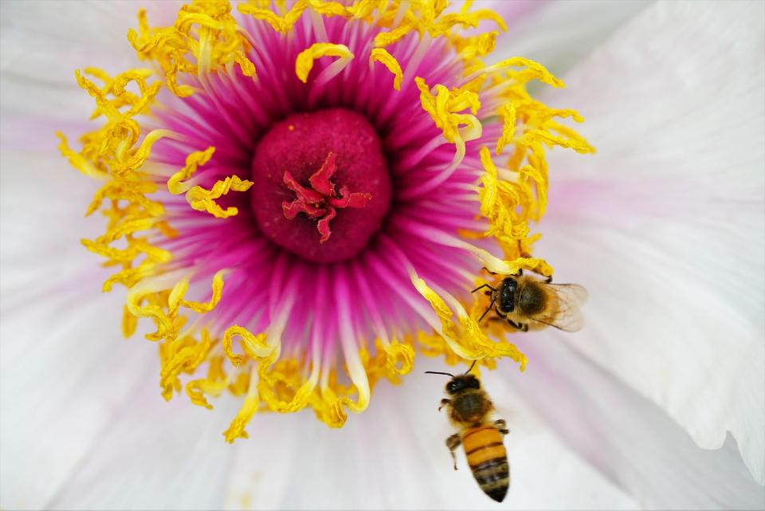
Notes:
Slide 17: For all that is beautiful in our world….

Slide 18
We will show we care.
Notes:
Slide 18: We will show we care.

Slide 19
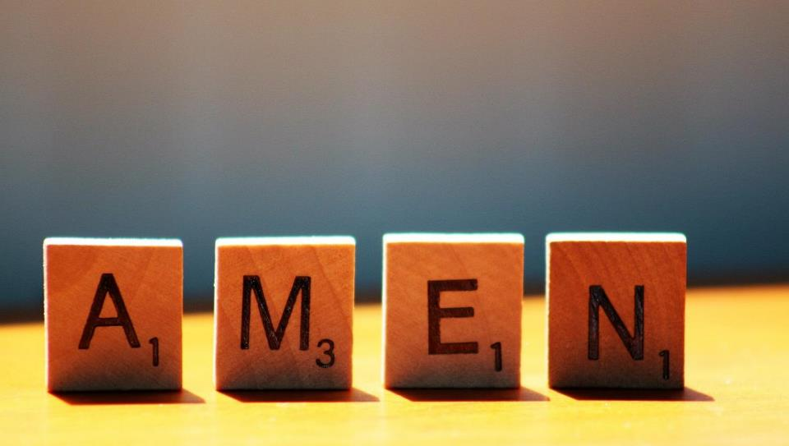

Slide 20
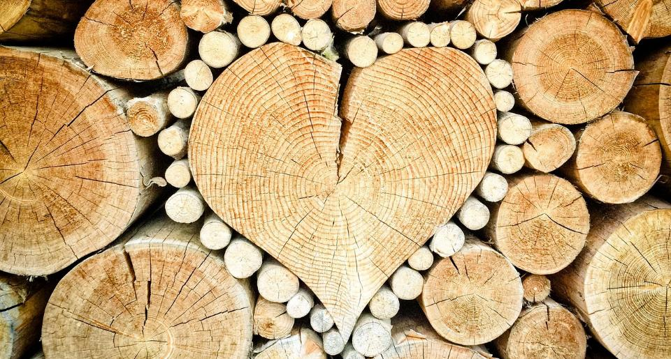


Leader: As we leave this place & time and go into the day ahead…
All: Together, we create a caring community!
Notes:
Sending: Slide 22 (NB note different word from last week!)
Leader: As we leave this place & time and go into the day ahead…
All: Together, we create a caring community!
BSL Together: https://www.signbsl.com/sign/together (1st video); Caring: https://www.signbsl.com/sign/care
You already have signs for ‘community’

Slide 21


Notes:
Slide 21: Reflective areas
Think: What do you feel is ‘broken’ in our world?
Talk: Talk together with others about your ideas – do you all have the same?
Why do you think this is?!
Do: Take a plaster.
Write or draw on it your idea, or a thought / prayer about what you’d like to see ‘fixed’.
Then stick it onto the world map or globe.

